Slide 1
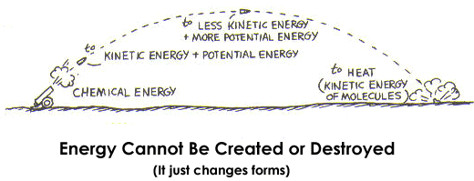
Conservation of Energy

Slide 2
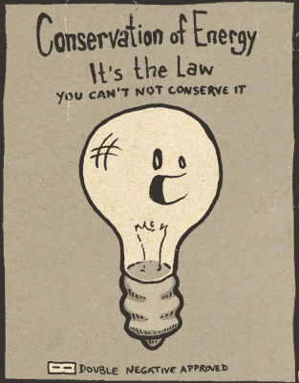
The Law of Conservation of Energy
Recall:
1. Energy CANNOT be created or destroyed (but it can be transferred from one form to another)
2. The total energy of any CLOSED SYSTEM remains the same
Notes:
Closed System = Isolated System

Slide 3
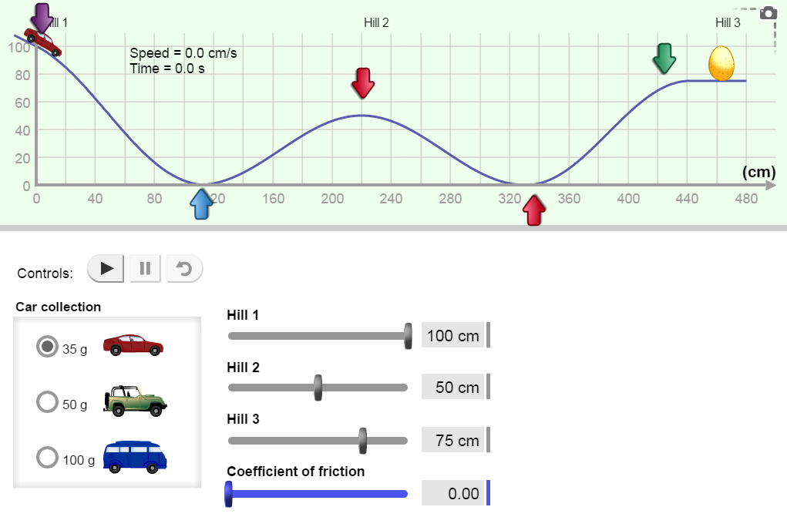
Explore Learning: Roller Coaster Physics
The “roller coaster” simulation demonstrates a closed system. This is one in which energy is not added or removed.
Answer the questions on your worksheet.
Notes:
Simulation through explorelearning.com

Slide 4
Explore Learning: Roller Coaster Physics
1. What happens as the car rolls down a ramp?
It speeds up → Kinetic Energy increases
It’s height decreases → Gravitational Potential Energy decreases
2. What happens as the car rolls up a ramp?
It slows down → Kinetic Energy decreases
It’s height increases → Gravitational Potential Energy increases

Slide 5
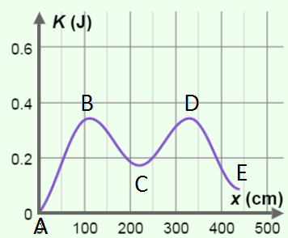
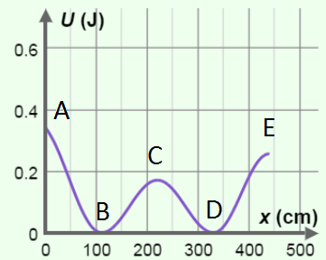
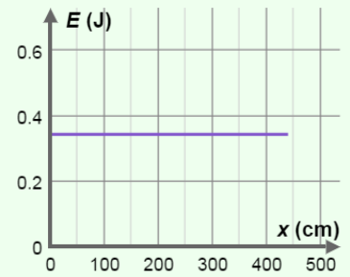
Explore Learning: Roller Coaster Physics
3. Sketch the graphs for each of the following:
Kinetic Energy Gravitational Potential Total Energy
Vs. Position Energy Vs. Position Vs. Position
Notes:
Why is the total energy a horizontal line?
Notice that the maximum values are equal to the total energy of the system

Slide 6
Total Mechanical Energy
The total mechanical energy refers to an objects energy due to motion or position
E_{tot} = E_{K} + E_{g}
Since energy is not created or destroyed, E_{tot} will always be the same value!!!
As long as our reference level for E_{g} remains constant.
Notes:
Work through calculations from warm up sheet

Slide 7
Explore Learning: Roller Coaster Physics
4. a) At what point(s) is kinetic energy a maximum? B & D *these will give us the maximum speed
b) What is the value of the gravitational potential energy at this/these points? 0 J

Slide 8
Explore Learning: Roller Coaster Physics
5. a) At what point(s) is gravitational potential energy a maximum? A
b) What is the value of the kinetic energy at this/these points? 0 J
Notes:
Calculations done on the board
If one of the hills were higher it would not reach the top (not enough total energy in the system) *notice that it only rises as far as it fell from – assuming the initial speed is zero.

Slide 9
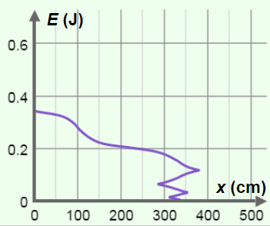
Explore Learning: Roller Coaster Physics
What do you think would happen if there was friction?
Some of the energy is converted to thermal energy. The system is no longer a “closed system”.

Slide 10

Example
A child sits in a swing. You pull the swing back, lifting it 52.1 cm vertically, and then let go. Determine the speed of the child and swing as the swing moves past its lowest point.
Notes:
In this question we can see that choosing an appropriate reference level (such as the lowest point of the swing rather than the ground) can make our calculations simpler.
We also see that mass does not affect the speed.

Slide 11
The Benefits of Energy
The law of conservation of energy allows us a way to determine an objects speed without having to work through kinematics.
Energy | Kinematics
Scalars | Vectors
Use total energy | Use 5 Kinematics Equations

Slide 12
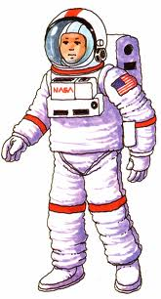
Example
An astronaut on the moon, where g is 1.6 N/kg, drops a 20 kg boulder from a height of 30 m. Calculate the speed of the boulder, just as it reaches the moon's surface using:
a) The kinematics equations
b) The law of conservation of energy

Slide 13


Slide 14
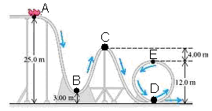
Try This!
The roller coaster cart has a mass of 250 kg. At point A it’s height is 25.0 m and it’s speed is 22 m/s. Calculate the total energy of the system. Assume the system is frictionless.
Notes:
*Given time constrains try this problem may be done the following day
Establish a common reference point
Assume there is no loss of energy due to friction
Note how this question is different from the warm up question!

Slide 15
Try This!
b) What is the total energy at each of the following points:
- B? - C? - D? - E?
c) What is the maximum speed of the roller coaster cart?
d) What is the maximum height for this roller coaster?
e) What is the speed at point C?
Notes:
As you can see, energy provides a simple way to determine speed values

